Slide 1
Layouts

Slide 2
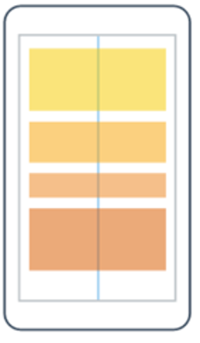
Creating UI VerticalStackLayout
Stacks its Children vertically, top-to-bottom
Places first child at the top
Places last child at the bottom
https://learn.microsoft.com/dotnet/maui/user-interface/layouts/media/layouts.png

Slide 3
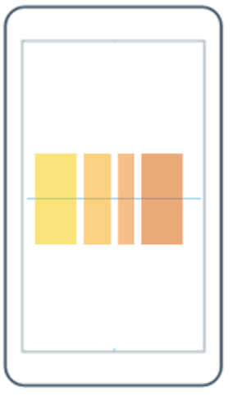
Creating UI HorizontalStackLayout
Stacks its Children horizontally, left-to-right
Places first child at the left
Places last child at the right
https://learn.microsoft.com/dotnet/maui/user-interface/layouts/media/layouts.png

Slide 4
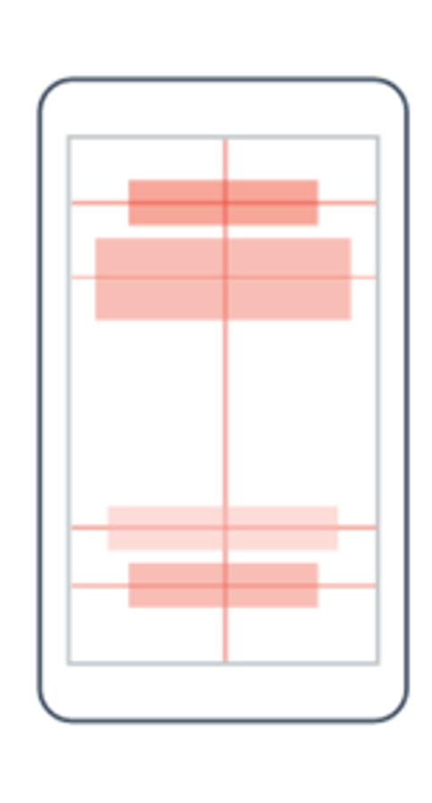
Creating UI AbsoluteLayout
Places its Children in an exact location
Can use pixel coordinates
Can use relative position
https://learn.microsoft.com/dotnet/maui/user-interface/layouts/media/layouts.png

Slide 5
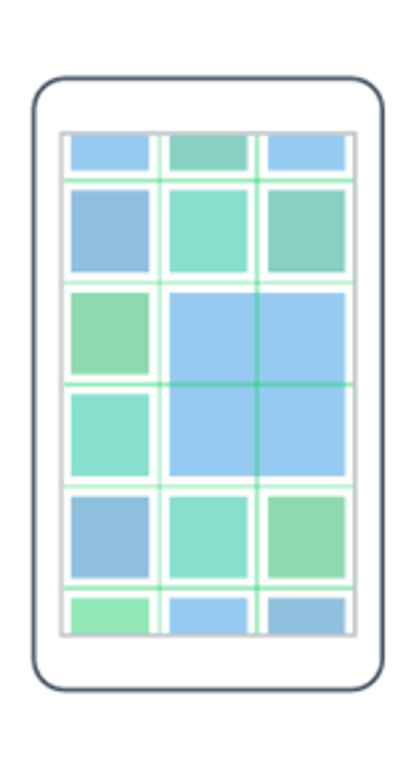
Creating UI Grid
Defines Rows + Columns using enums
Place UI controls inside specific Grid location
https://learn.microsoft.com/dotnet/maui/user-interface/layouts/media/layouts.png

Slide 6
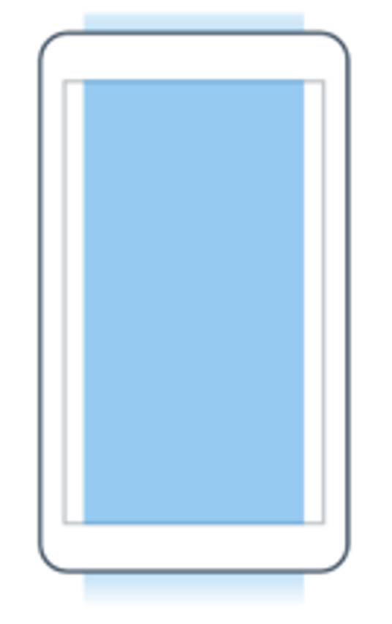
Creating UI ScrollView
Allows Layouts to extend past the screen
Enables scrolling
Can either scroll Vertically, Horizontally, or Both
https://learn.microsoft.com/xamarin/xamarin-forms/user-interface/layouts/scrollview-images/layouts.png

Slide 7
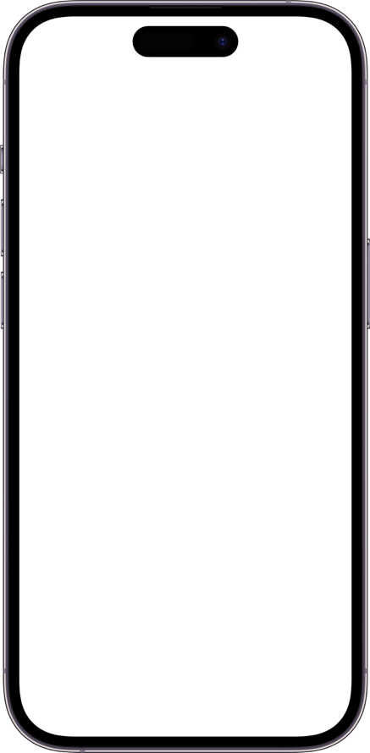
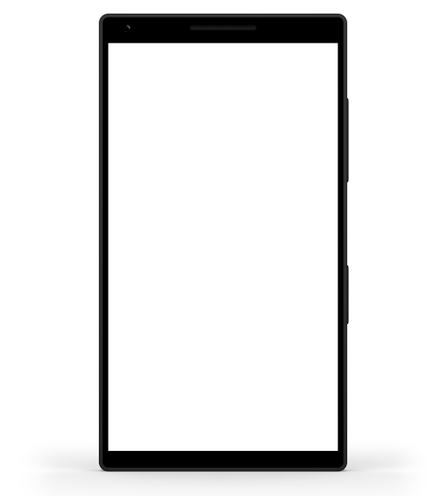
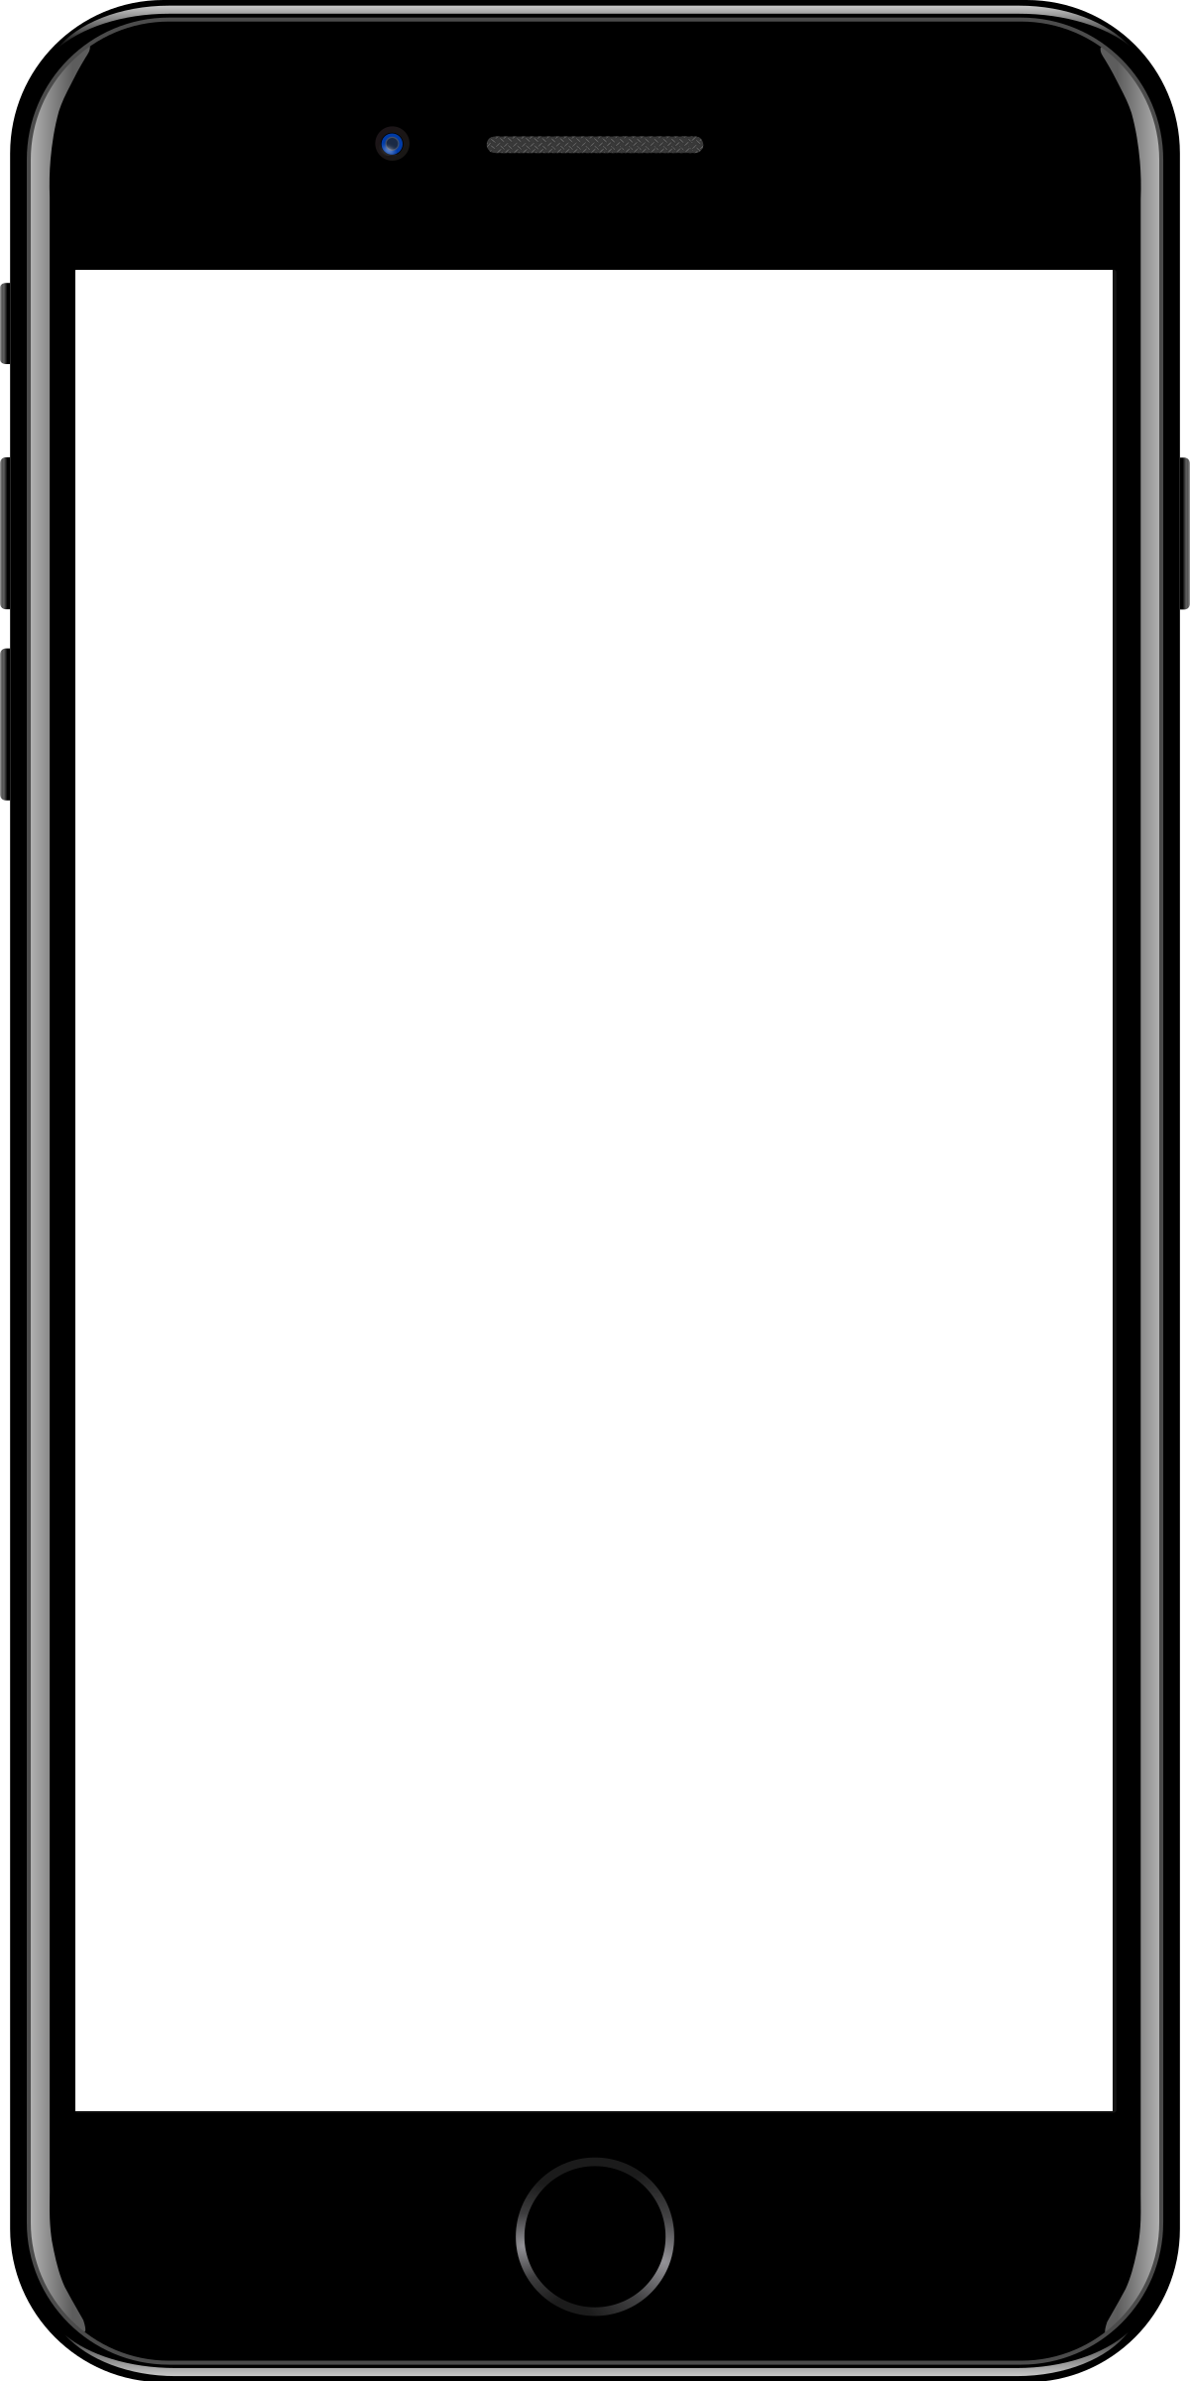
Sample mobile app slide
iPhone 7/8
iPhone 14
Generic phone
(BrandCentral)
App screenshots can be placed behind these transparent .pngs

Slide 8
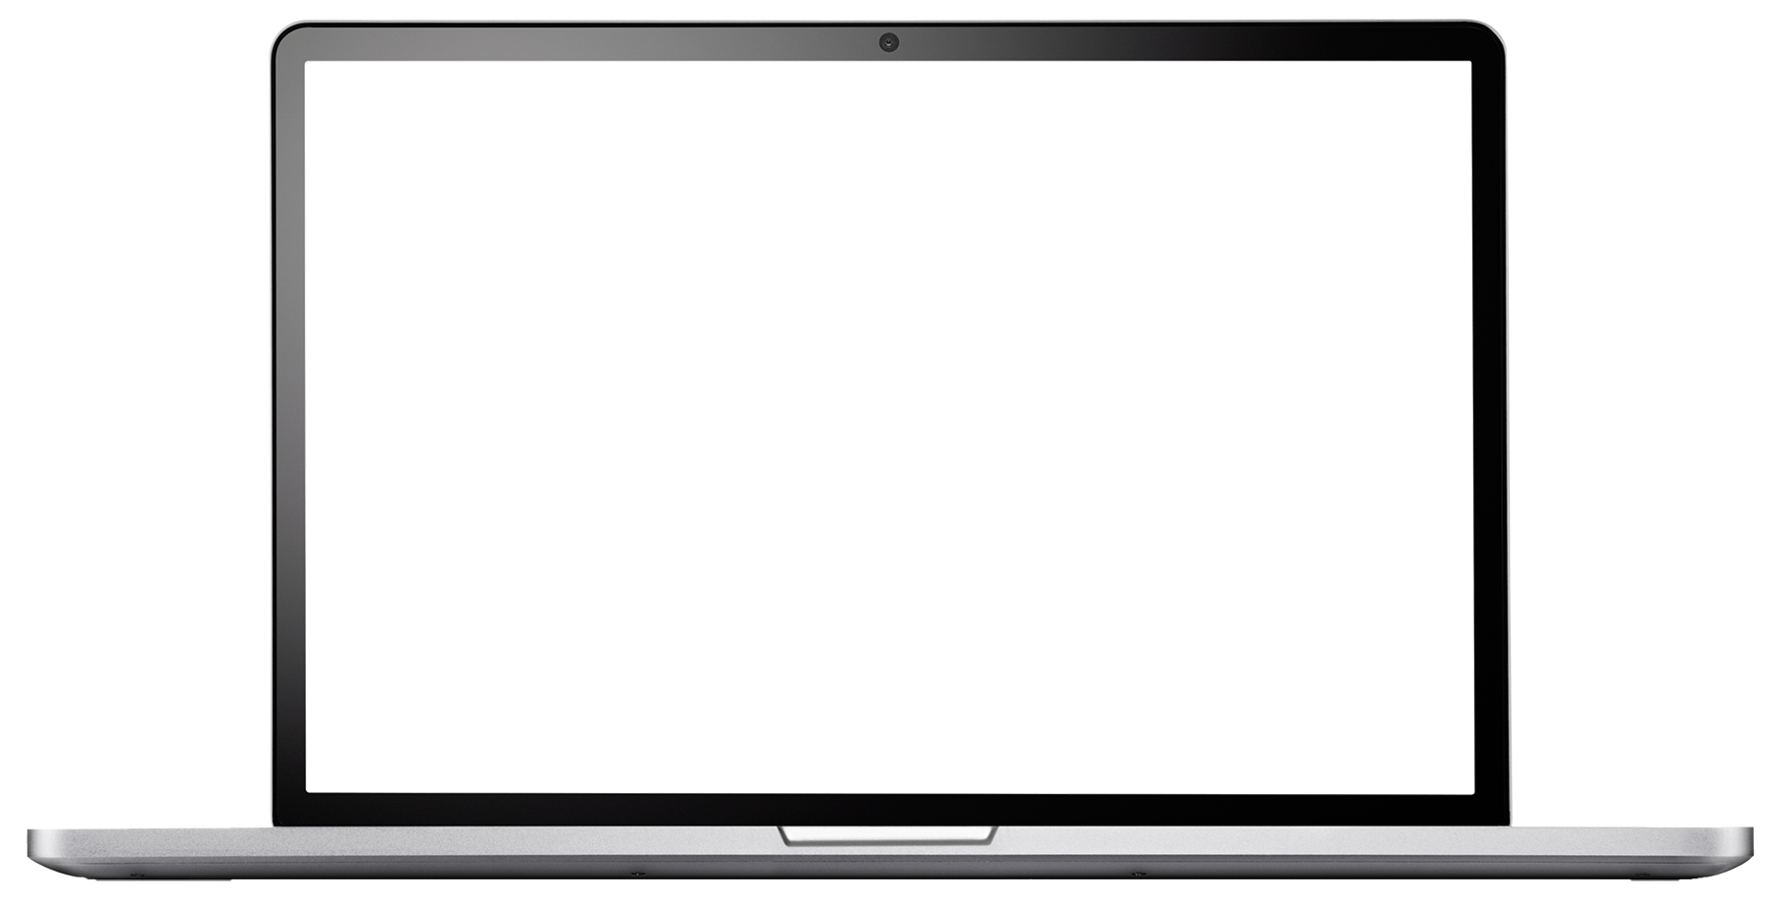
Sample website slide (blank)
Website screenshots can be placed behind this transparent .png

Slide 9
Bullet points layout with subtitle Subtitle is smaller in the same text block
Example of a bulleted slide with a subhead
Set the slide title to “Sentence case”
Set subheads to “Sentence case”
Hyperlink style
www.microsoft.com

